Slide 1
THG Simulations
Project update
Week 5
18/08/2023
David Amorim

Slide 2
Overview
Effects of chirp
Gas comparison (updated)
New COMSOL simulations

Slide 3
I. EFFECTS OF CHIRP

Slide 4
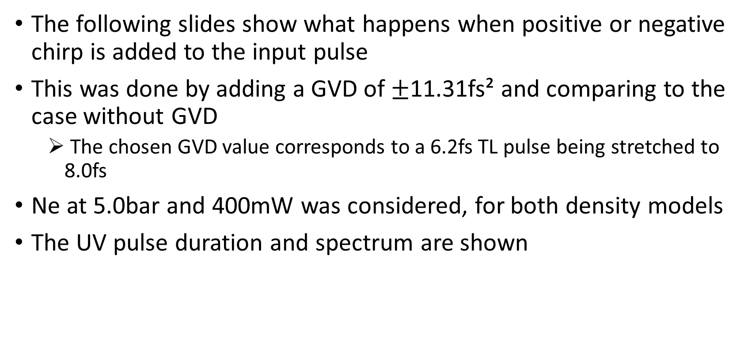
Effects of chirp
The following slides show what happens when positive or negative chirp is added to the input pulse
This was done by adding a GVD of $±$11.31fs² and comparing to the case without GVD
The chosen GVD value corresponds to a 6.2fs TL pulse being stretched to 8.0fs
Ne at 5.0bar and 400mW was considered, for both density models
The UV pulse duration and spectrum are shown

Slide 5
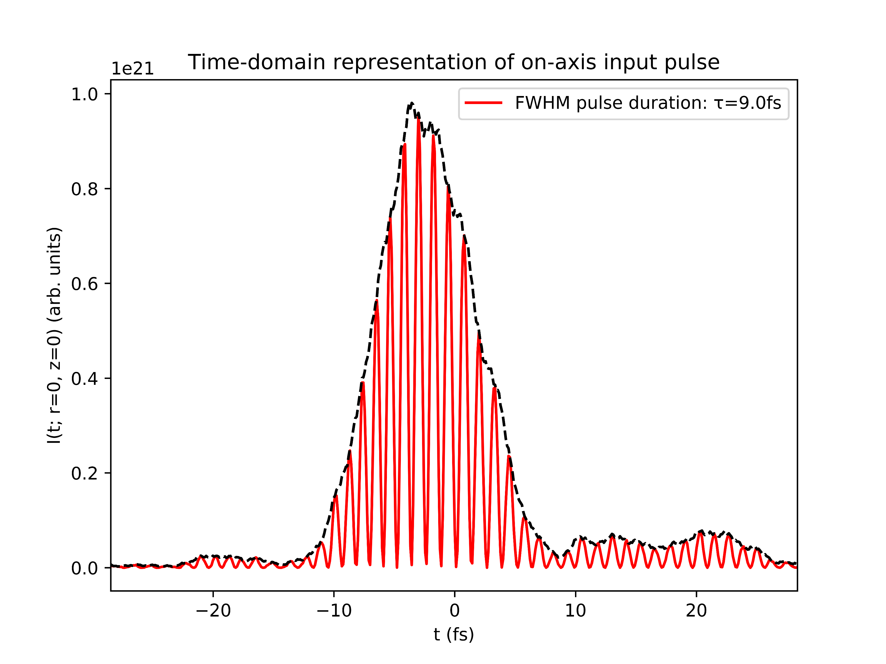
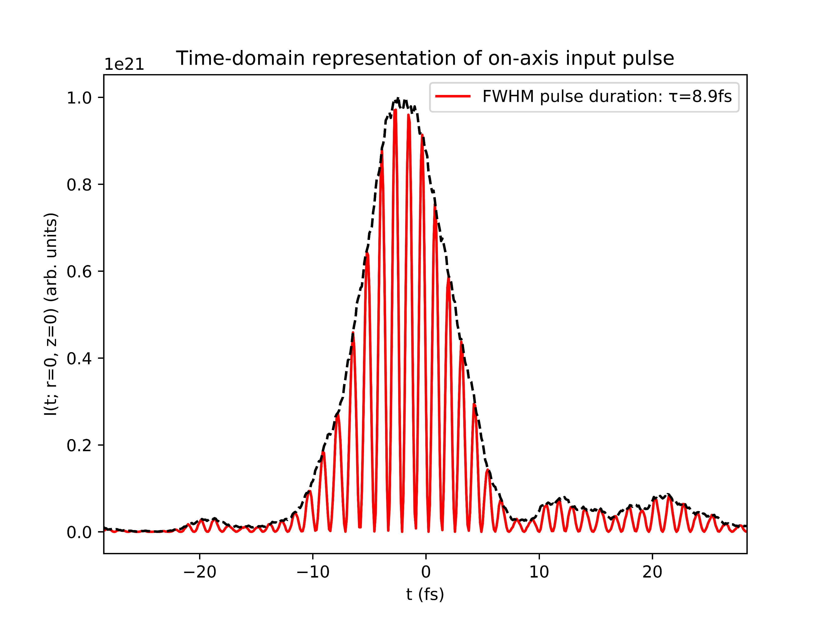
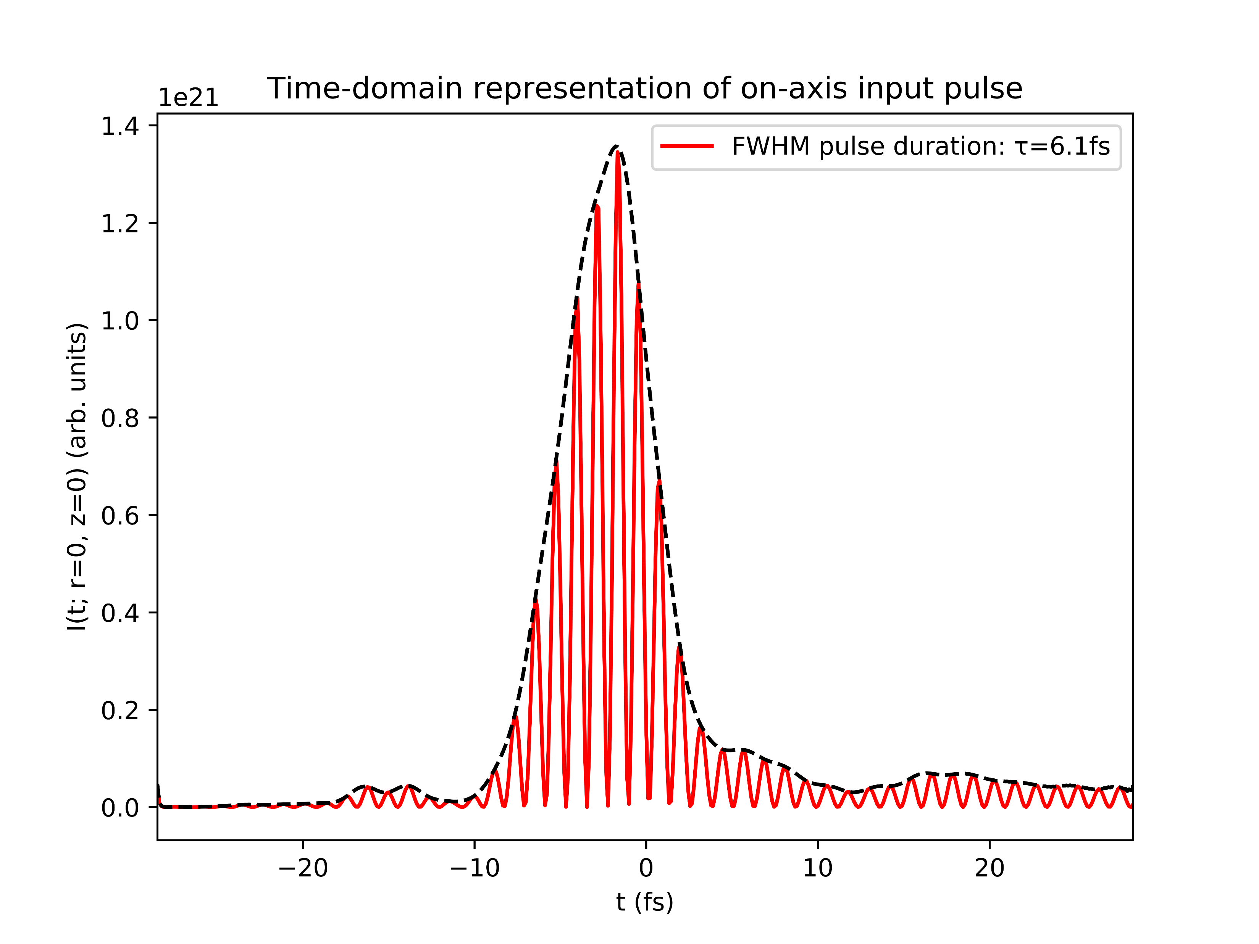
Effects of chirp: both models
+ve chirp
no chirp
-ve chirp

Slide 6
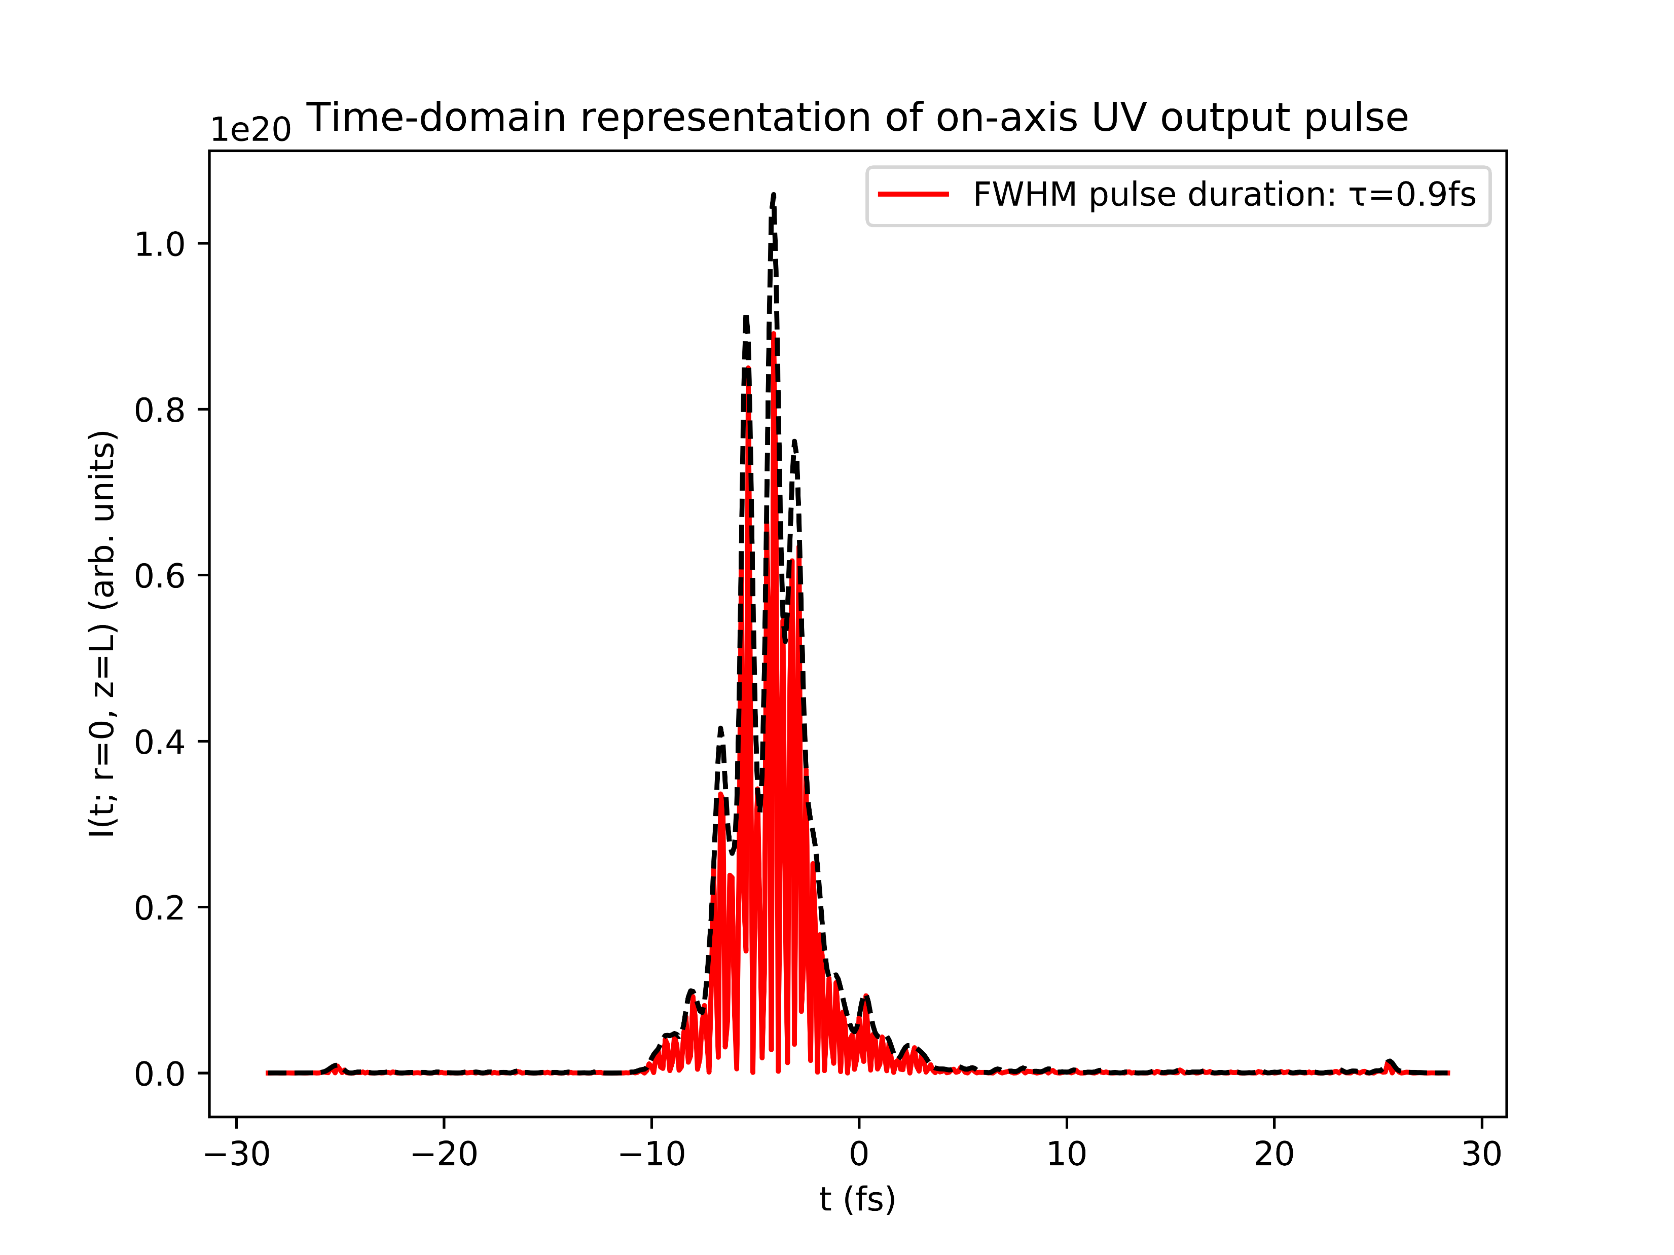
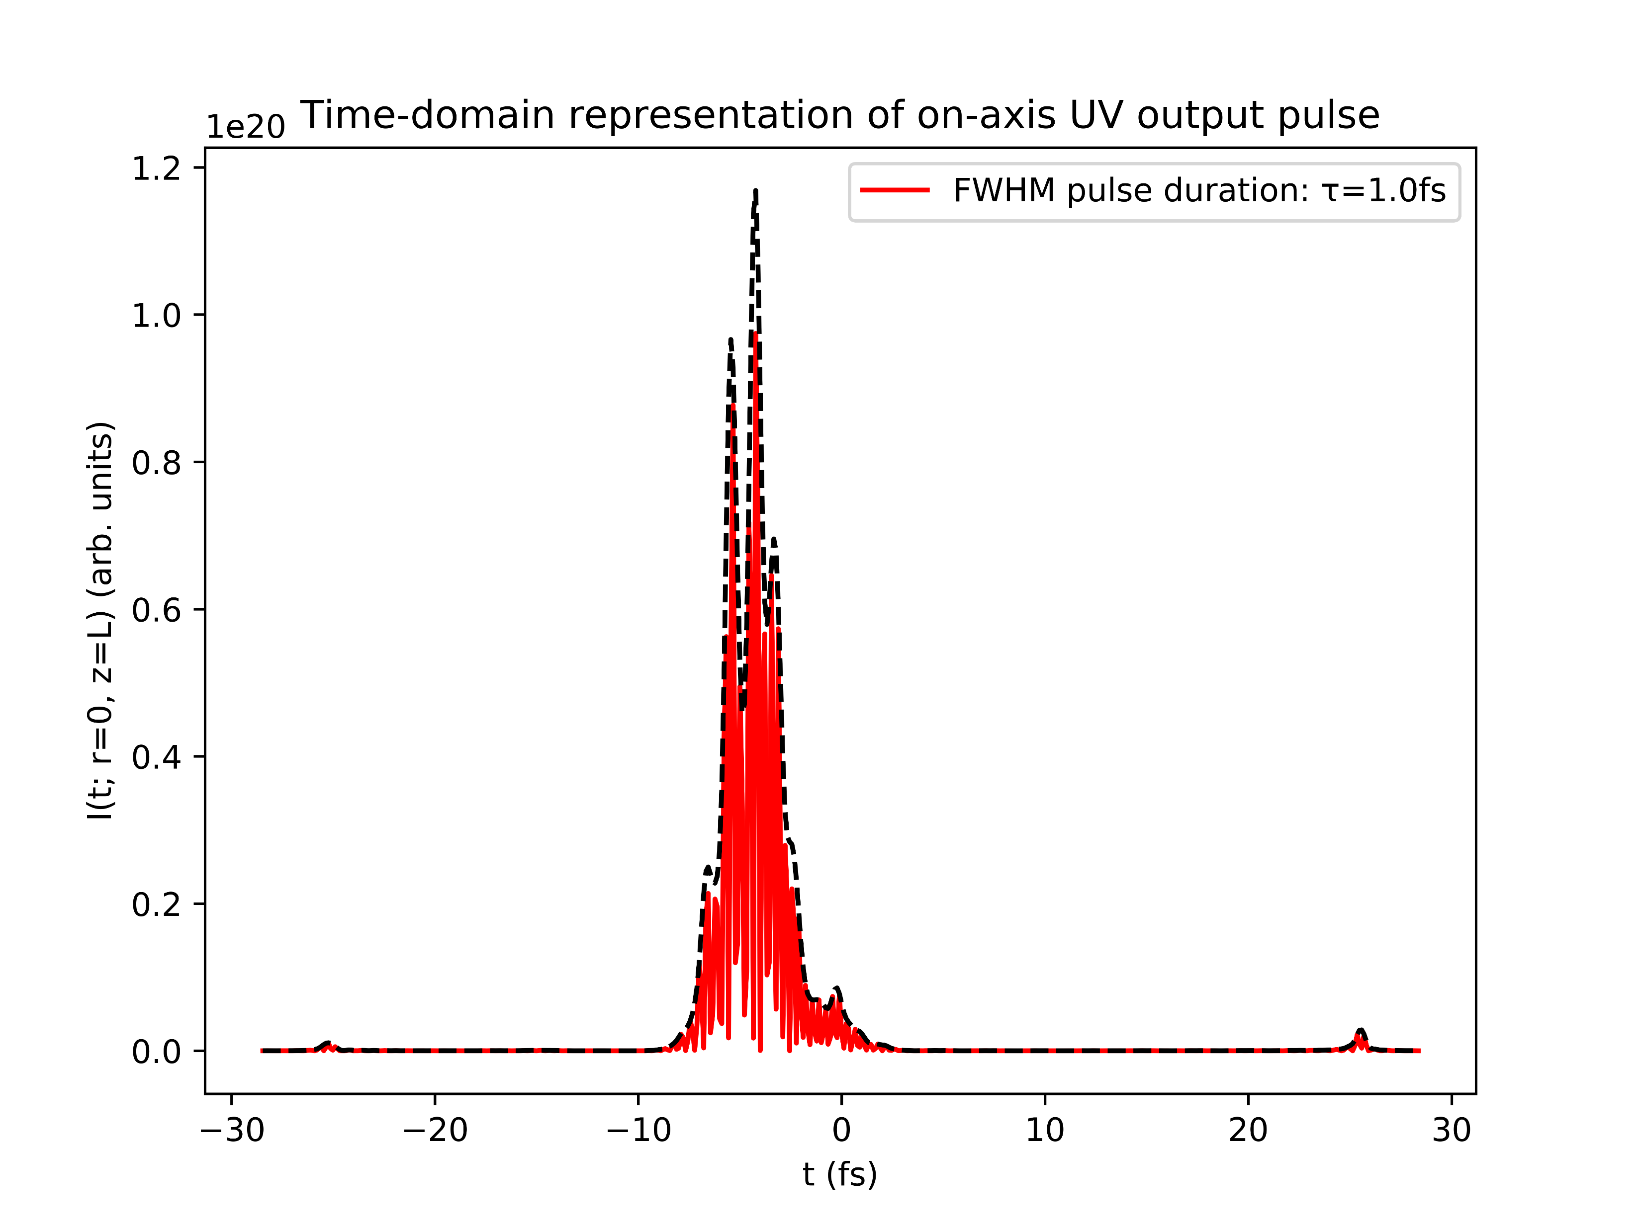
Effects of chirp: gradient model
+ve chirp
no chirp
-ve chirp

Slide 7
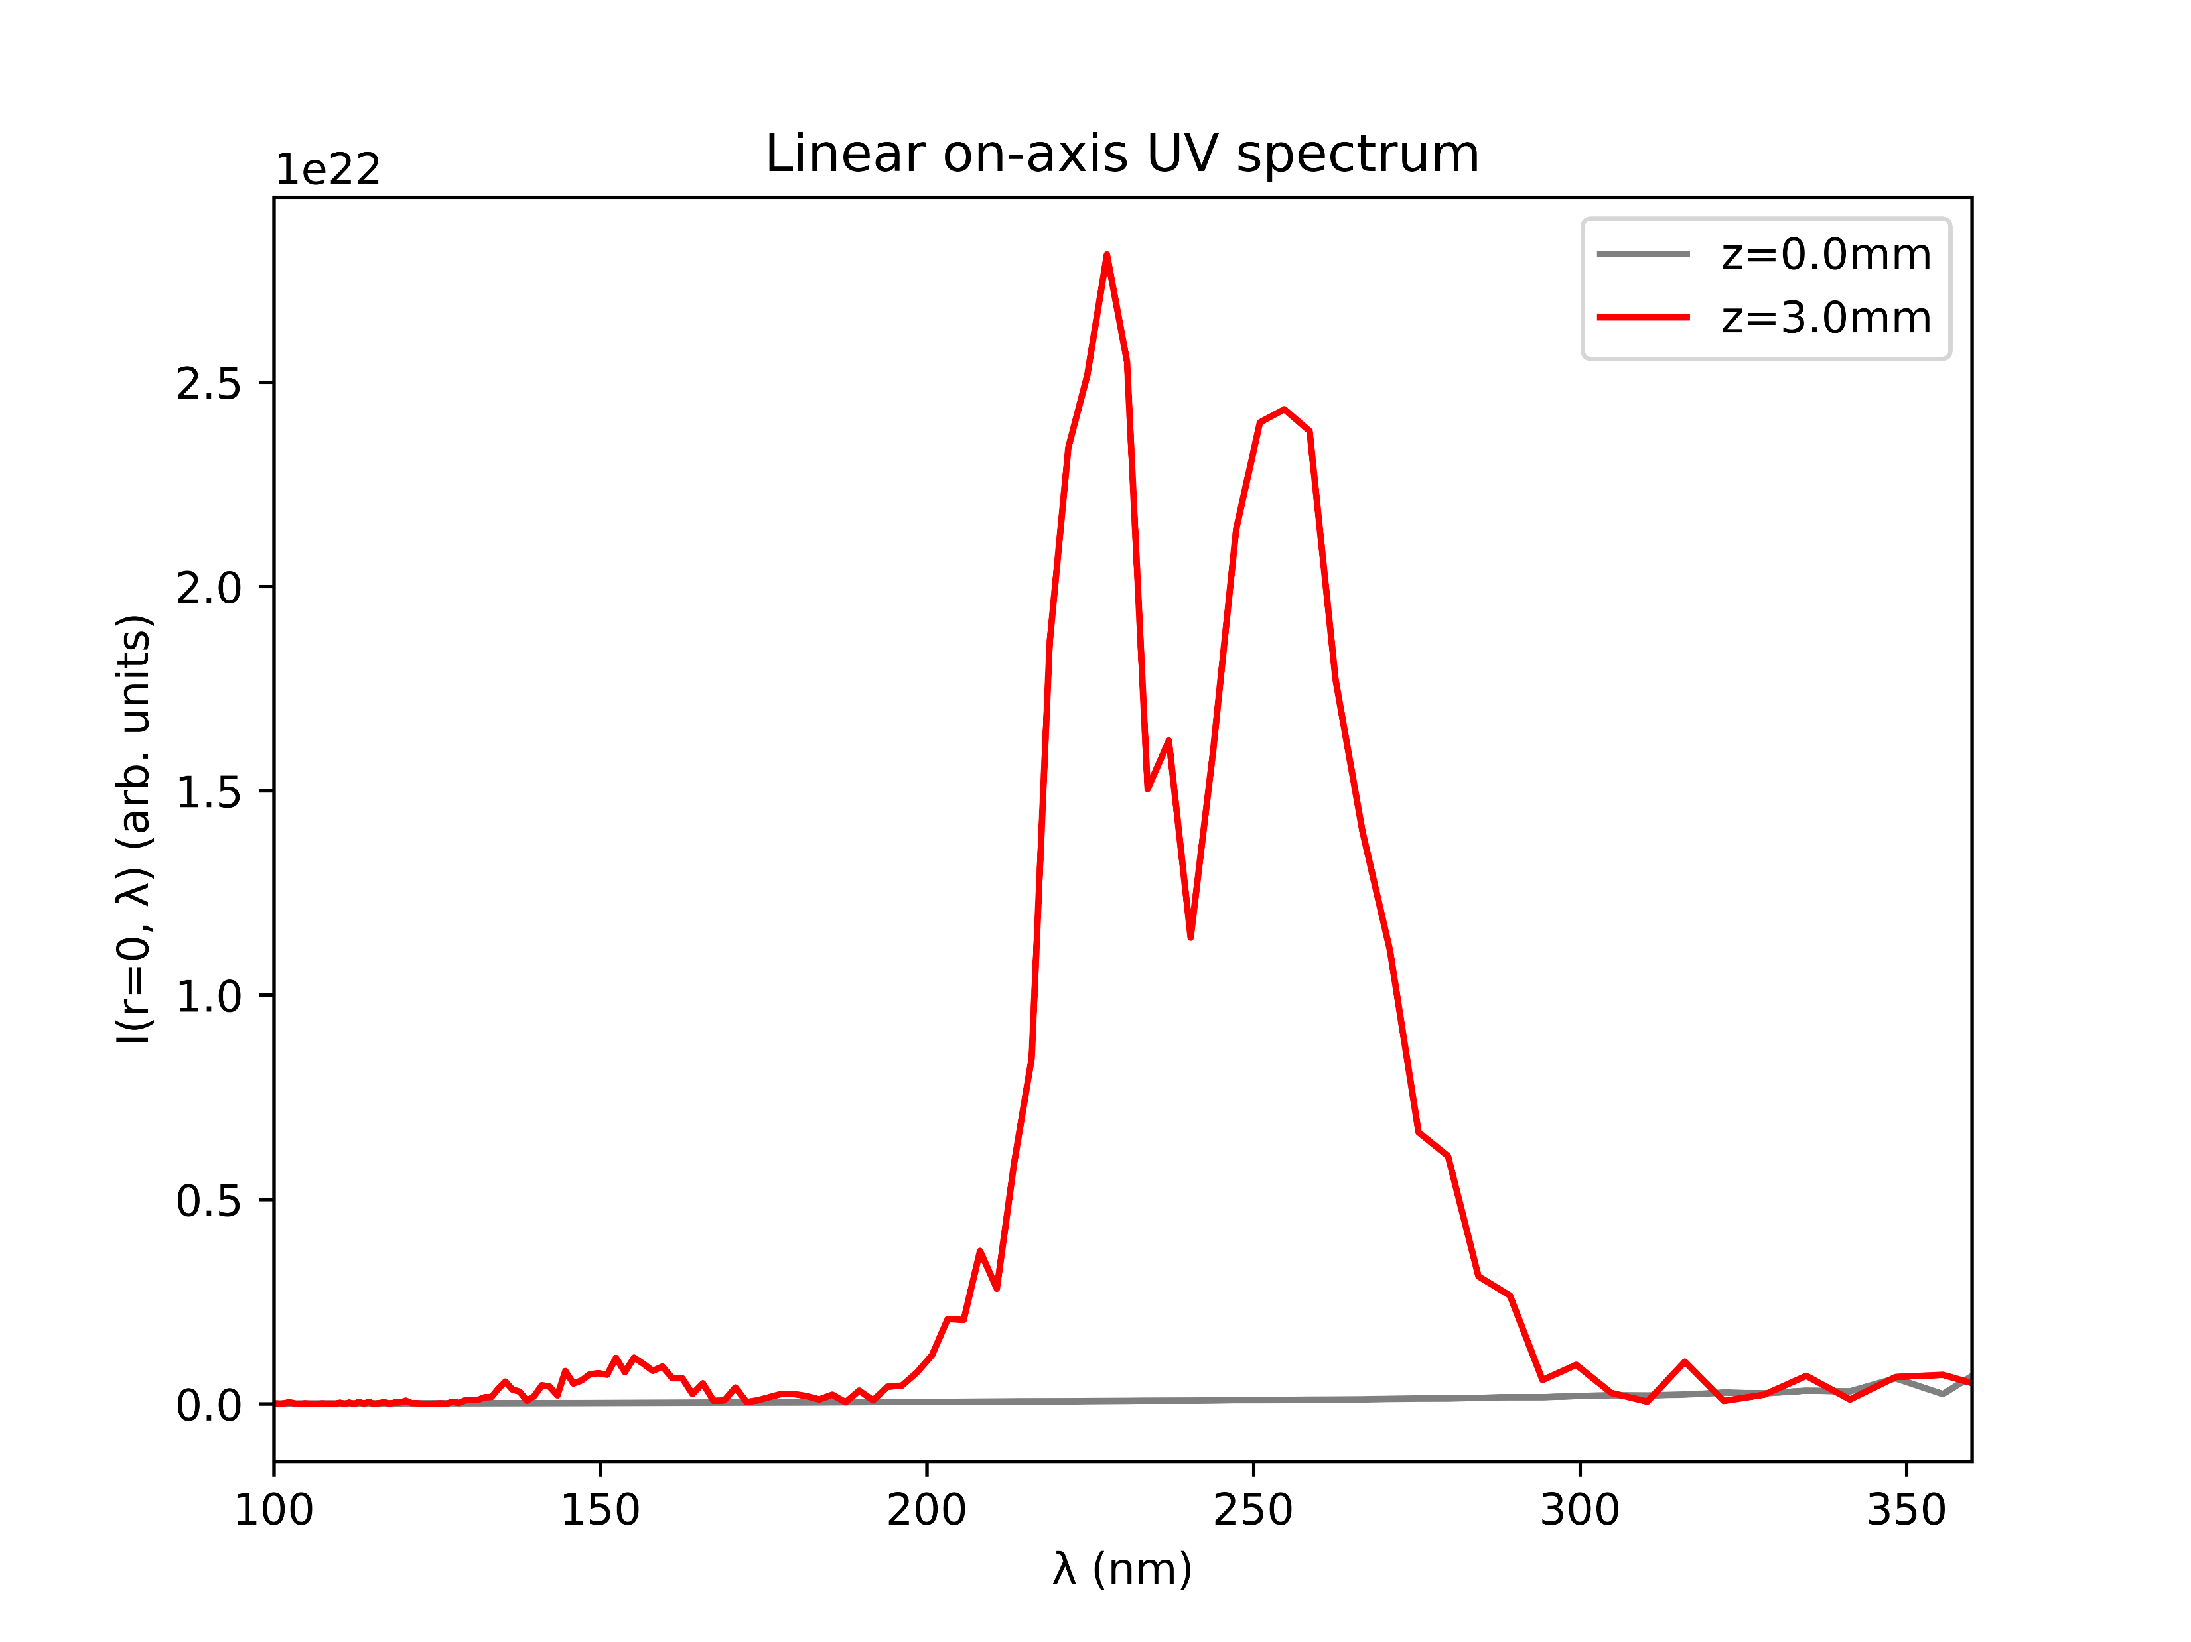
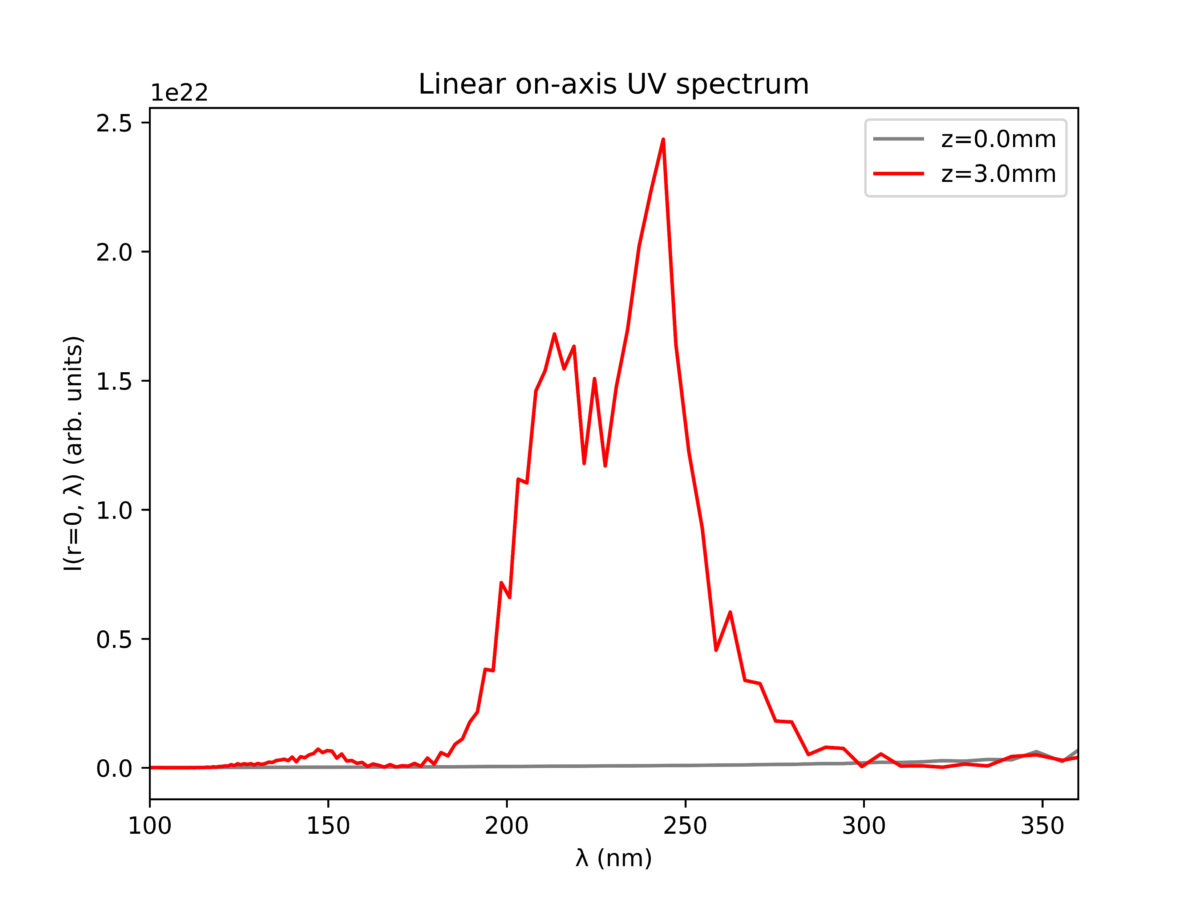
Effects of chirp: gradient model
+ve chirp
no chirp
-ve chirp

Slide 8
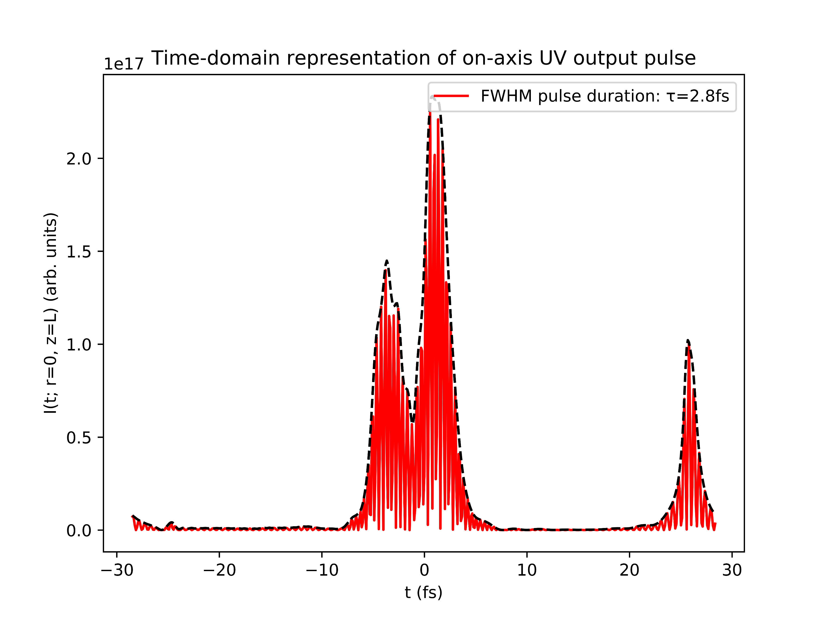
Effects of chirp: COMSOL model
+ve chirp
no chirp
-ve chirp

Slide 9
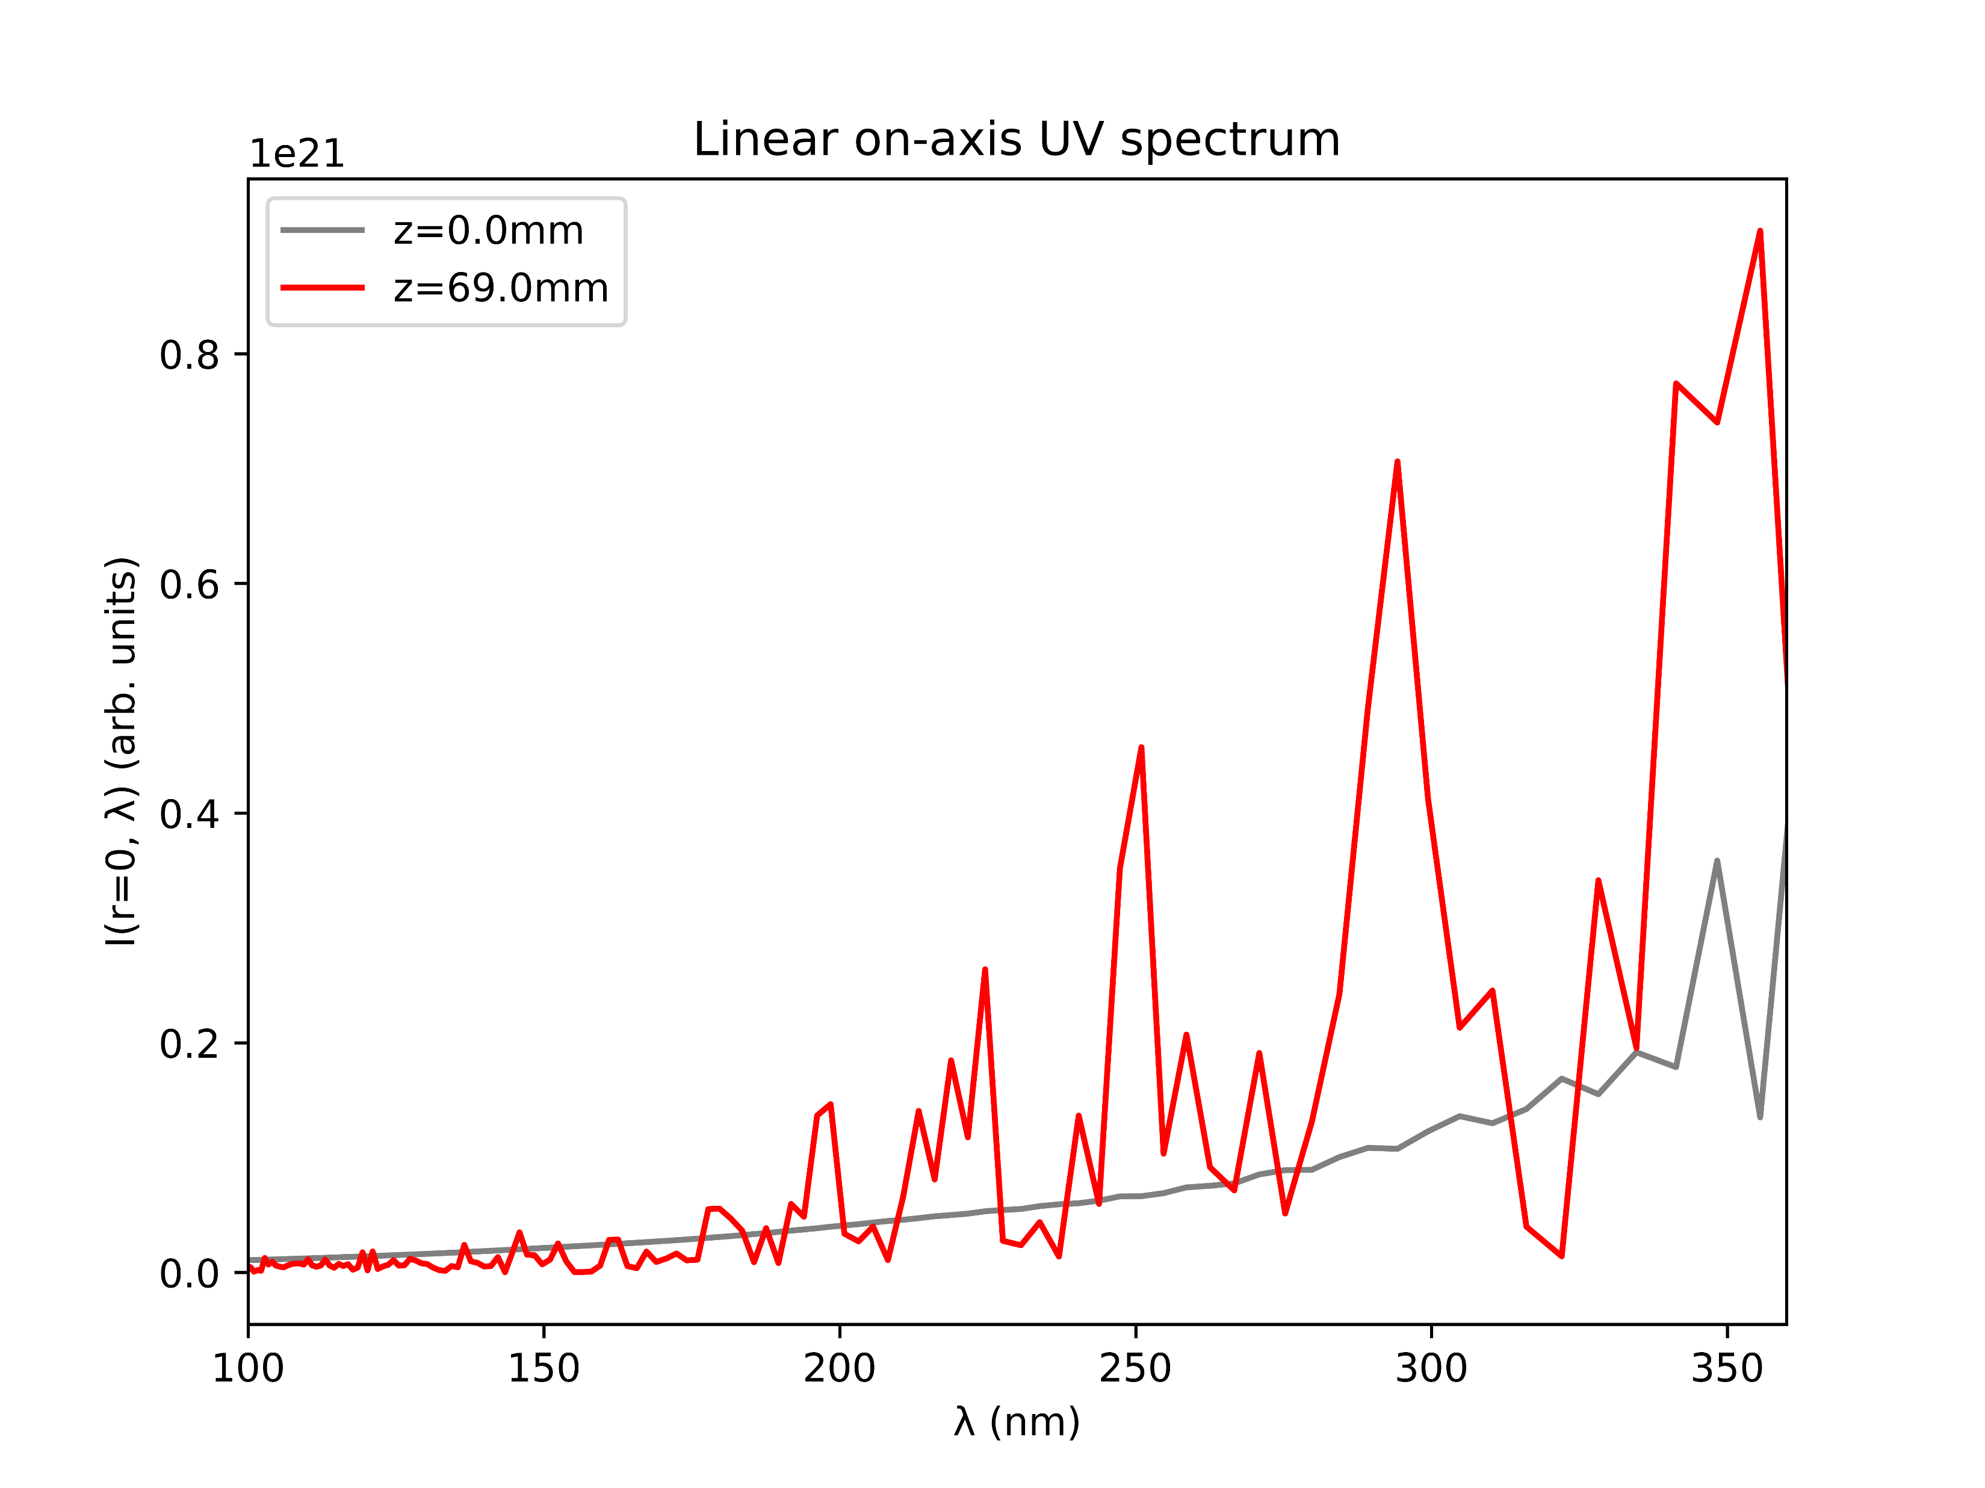
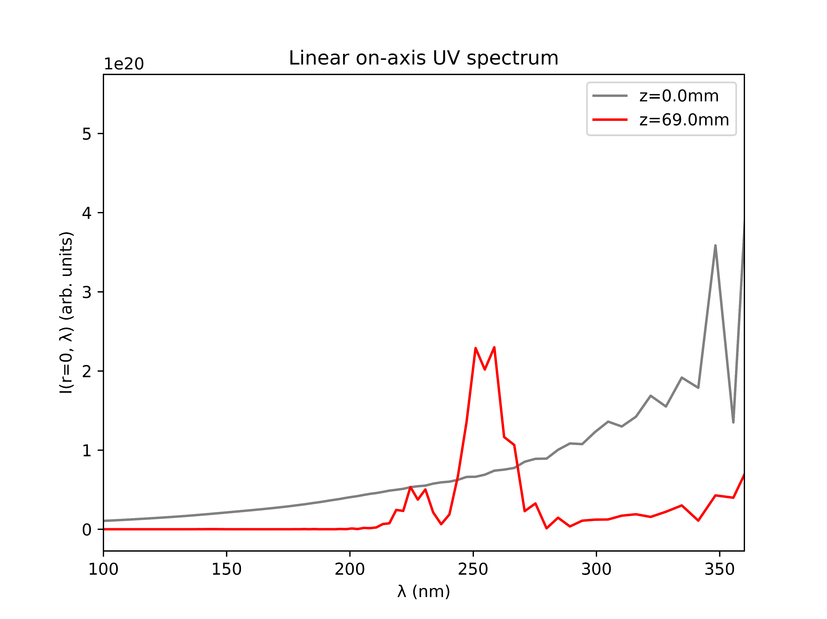
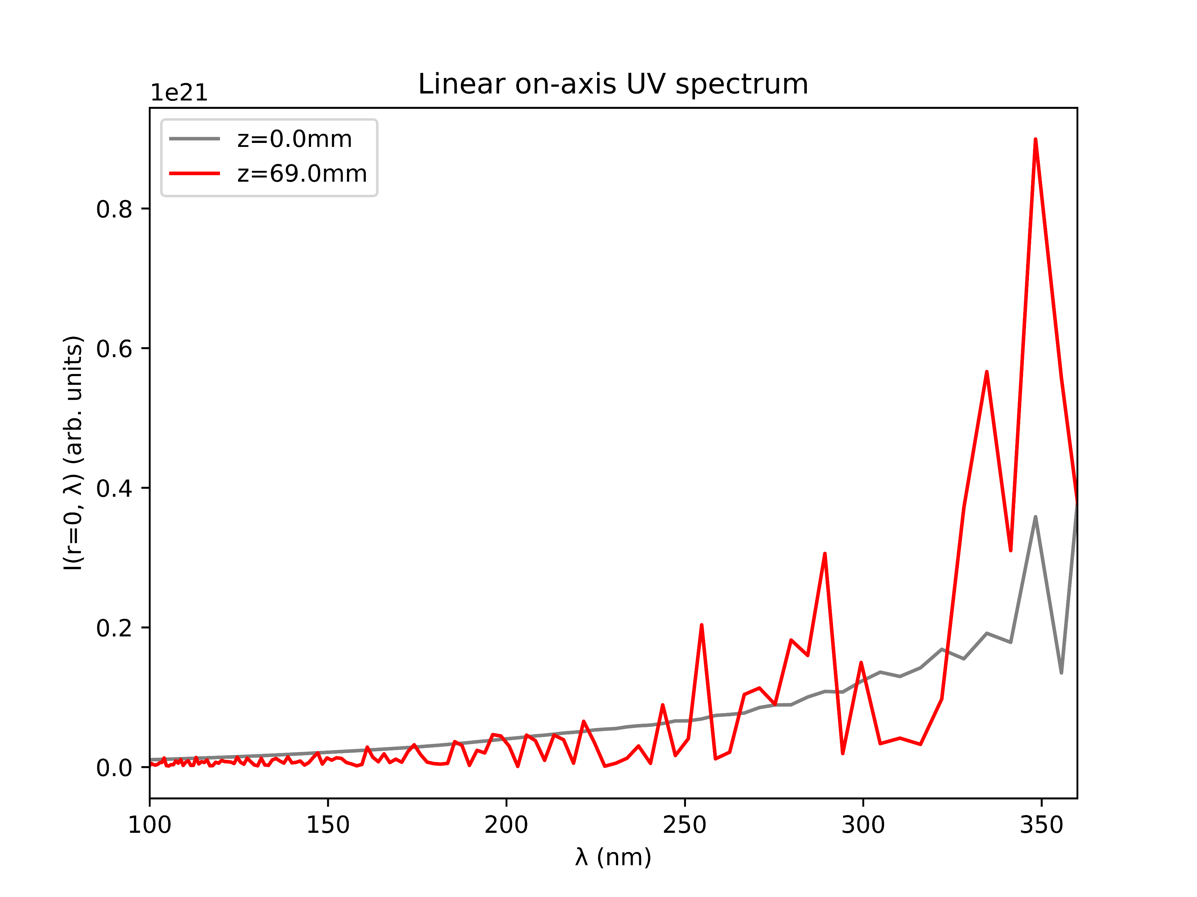
Effects of chirp: COMSOL model
+ve chirp
no chirp
-ve chirp

Slide 10
Effects of chirp: conclusion
Introducing chirp results in short pulses in both the COMSOL and gradient models
negative chirp seems to produce slightly shorter pulses than positive chirp
In the gradient model, the chirp increases UV intensity and narrows the spectrum around the THG peak
In the COMSOL model, UV intensity is increased overall but additional peaks are introduced which are more intense than the THG peak
Investigate this more?
Look at Argon, different pressures and beam powers, different chirp values…

